Slide 1
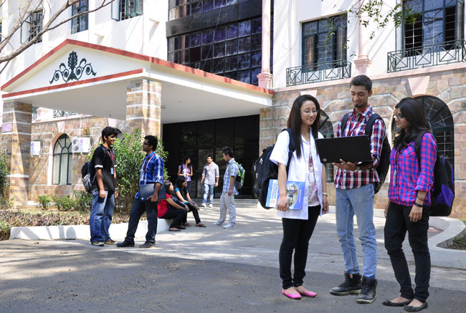

CSB4301 – Theory of Computation
B.Tech – IVth Semester
Regular Expressions
Mr. D.S.John Deva Prasanna AP(SG)
Department of Computer Science and Engineering

Slide 2
Regular Expression(RE)

Slide 3
Introduction
Notation to specify a language
It is declarative
Fundamental in some languages like perl and applications like grep or lex
Capable of describing the same language as a NFA/DFA/Epsilon NFA
RE /DFA /NFA/e NFA – all can represent the same language.
The languages that are represented using Regular Expressions are called as Regular Languages.
We can define an algebra for regular expressions

Slide 4
Rules for Defining a Regular Expression(RE)
Any symbol in a alphabet is a RE. If ‘a’ is a symbol then ‘a’ is a RE which represents a language with one string {a}.
‘ε’ is a RE which represents a language with empty string {ε}
R1+R2 is a RE where R1 and R2 are REs, here ‘+’ signifies union (sometimes ‘|’ is used).
R1.R2 is a RE where R1 and R2 are regular expressions and this ‘ . ’ denotes concatenation

Slide 5
Rules for Defining a Regular Expression(RE)
5. R* is a RE where R is a regular expression and signifies closure(0 or more occurrences )
6. (R) -If R is a RE then parenthesized R is also a regular expression
The above rules need to be applied recursively.

Slide 6
Some notations and operators for REs
Union (+) – a+b will represent a language with two strings {a,b}
Concatenation (.) – a.b will represent a language with only one string {ab}
Kleene Star/Closure (*) – means 0 or more instances of a symbol or alphabet
a* is {a⁰ + a¹ + a² + a³ ....... a^{n} } will represent a language with infinite no of strings{ε,a,aa,aaa,aaa.....}

Slide 7
Prove that (0.(0+1)) is a RE over the alphabet {0,1}
Proof
0 is a symbol in alphabet hence ‘0’ is a RE – by Rule 1
1 is a symbol in alphabet hence ‘1’ is a RE – by Rule 1
If ‘0’ and ‘1’ are REs then 0+1 is a RE – by Rule 3
If 0+1 is a RE then (0+1) is a RE – by Rule 6
We know ‘0’ is a RE and (0+1) is a RE the 0.(0+1) is a RE – by rule 4
If 0.(0+1) is a RE then (0.(0+1)) is RE . –by Rule 6
Hence Proved

Slide 8
Finding the language represented by a RE
Find the language represented by the RE 001.
Here one instance of ‘0’ is concatenated with another one instance of ‘0’ and again concatenated with one instance of ‘1’.
0.0.1 = 001 which represents a single string ‘001’.
Hence the language is L(001) = {001}

Slide 9
Finding the language represented by the RE 0+10*
A single instance of ‘0’
Here we have only one string {0}
OR (represented using +)
A single instance of ‘1’ concatenated with zero or more instances of ‘0’s.
Here we have a infinite set of strings {1,10,100,1000,1000}
Hence the result is the union of above two sets.
L(0+10*) = { 0, 1, 10, 100, 1000, 10000, … }

Slide 10
Find the language represented by the RE (0*10*)
(0*10*)
- Zero or more instances of ‘0’ concatenated with a single instance of ‘1’ concatenated Zero or more instances of ‘0’.
(note: here the number of ‘0’s before ‘1’ and after ‘1’ need not be same )
So the language has infinite no of strings={1, 01,010,0100,0010,......}
(0*10*) = {1, 01, 10, 010, 0010, …} i.e. {w | w has exactly a single 1}

Slide 11
Find the language represented by the RE (0(0+1))*
(0(0+1))*
Single instance of ‘0’ concatenated with (0+1)
(0+1) – means one instance of ‘0’ OR one instance of ‘1’
So 0.(0+1) is going to be either ‘00’ or ‘01’
BUT LOOK AT THE * SYMBOL FOR THE ENTIRE EXPRESSION; the above two strings can repeat in any order for any number of times.
L((0(0+1))*) = { ε, 00, 01, 0000, 0001, 0100, 0101, …}----note the ‘ε’

Slide 12
Some RE and the Languages they represent
L((0+ε)(1+ ε)) = {ε, 0, 1, 01}
R.ε = R
R+Ø = R

Slide 13
Checking whether the string belongs to the a RE
There is no shortcut ...
Take a RE and generate some sample strings and understand the string patters generated by the RE.
Then take the given string given to us for verification and check it against the observed pattern.

Slide 14
Check whether the string 0111 belongs to the language represented by 01*
Here the RE is 01*
One instance of ‘0’ concatenated with zero or more instances of ‘1’s.
So the strings will be
0.1⁰ = 0.ε = 0
0.1¹ = 0.1= 01
0.1²= 0.11= 011
0.1³= 0.111= 0111
Hence the string “0111” belongs to the language

Slide 15
Checking whether the string 000100 belongs to the RE (0(0+1))*
The observed pattern for the above RE is multiple repetitions of 00 and 01 so some samples are {ε, 00,01,0000,0001,0100,000001...}
Here the given string is 00 01 00 then it surely falls in the pattern observed hence 000100 belongs to the language generated by (0(0+1))*

Slide 16
Thank You

